Slide 1



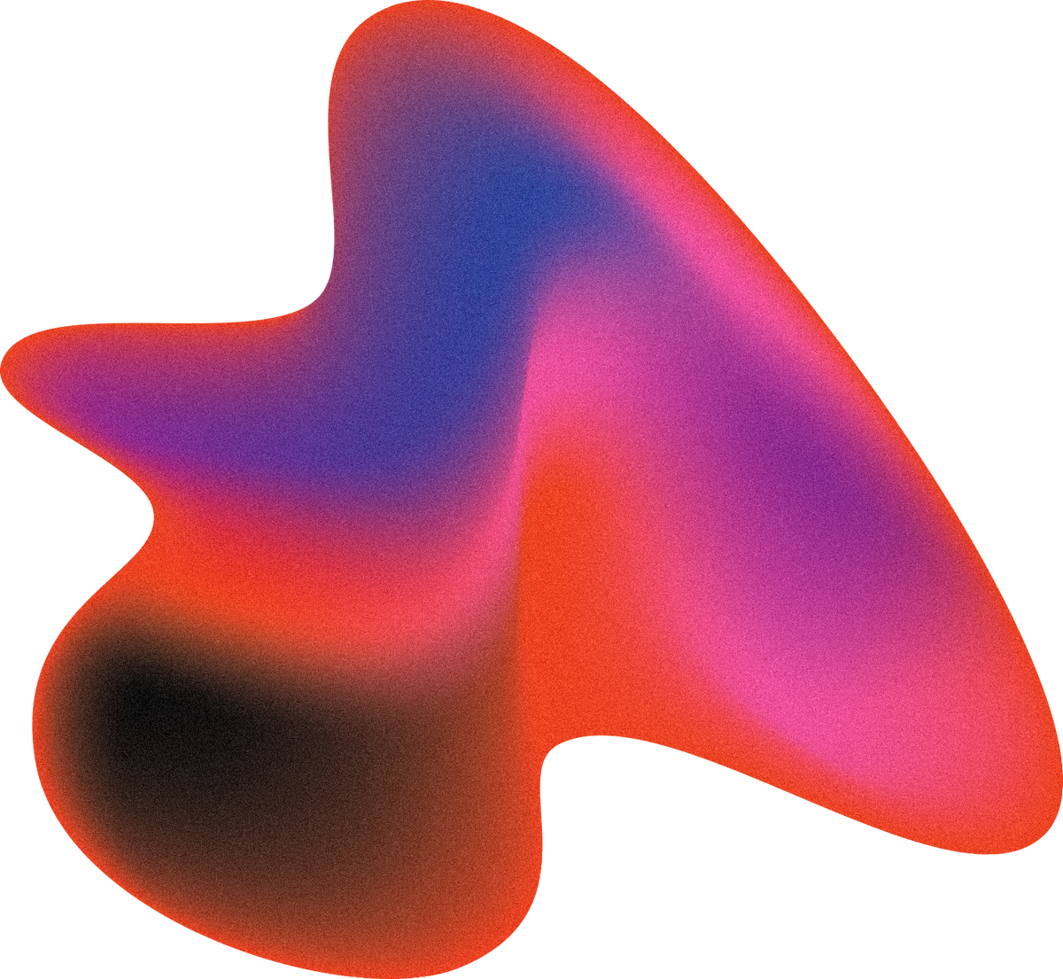
PHISHING WEBSITE DETECTION
Using Machine Learning
Leila, Lidzy, and Zuleyka

Slide 2
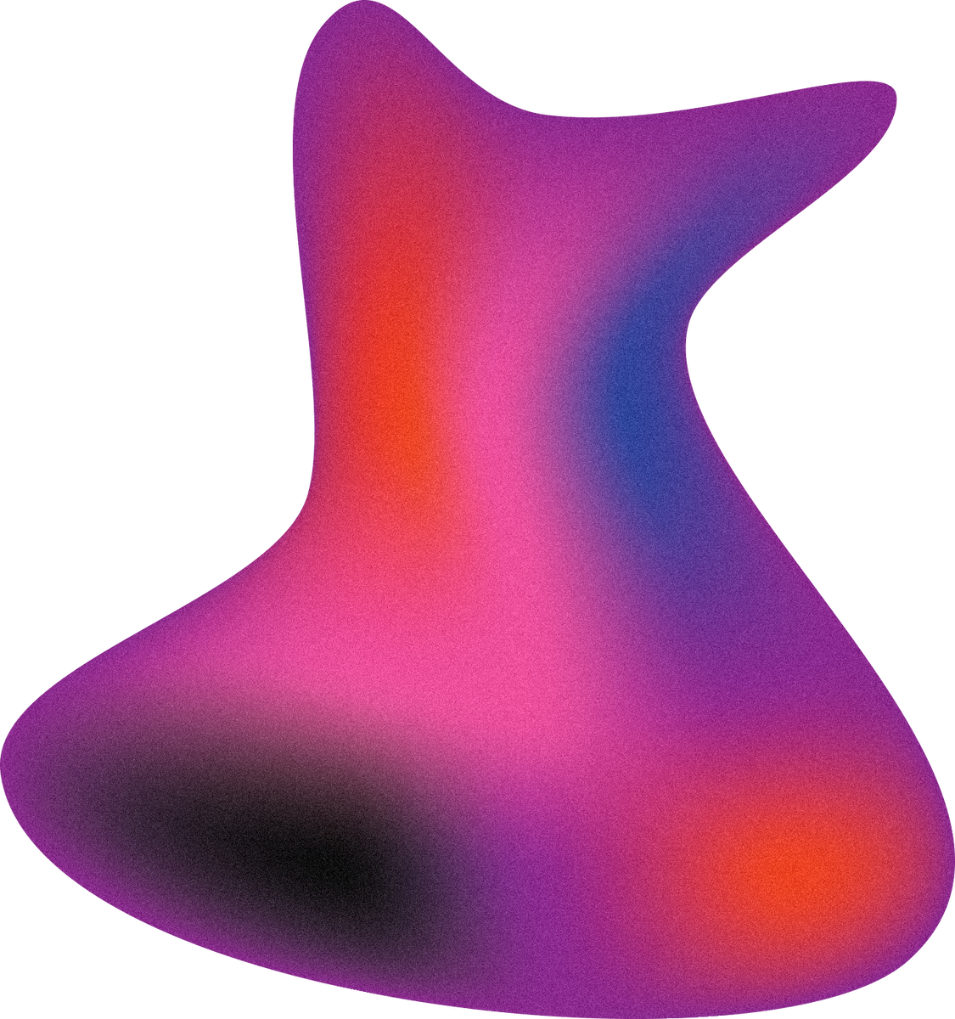
Problem Overview
What is Phishing?
Form of cyberattack where malicious websites impersonate legitimate ones to steal sensitive user information such as:
passwords
credit card details
social security numbers
banking credentials
Why is it Important to Detect?
Detecting phishing websites is essential for protecting sensitive information, strengthening cybersecurity, and preventing financial and reputational damage.

Slide 3
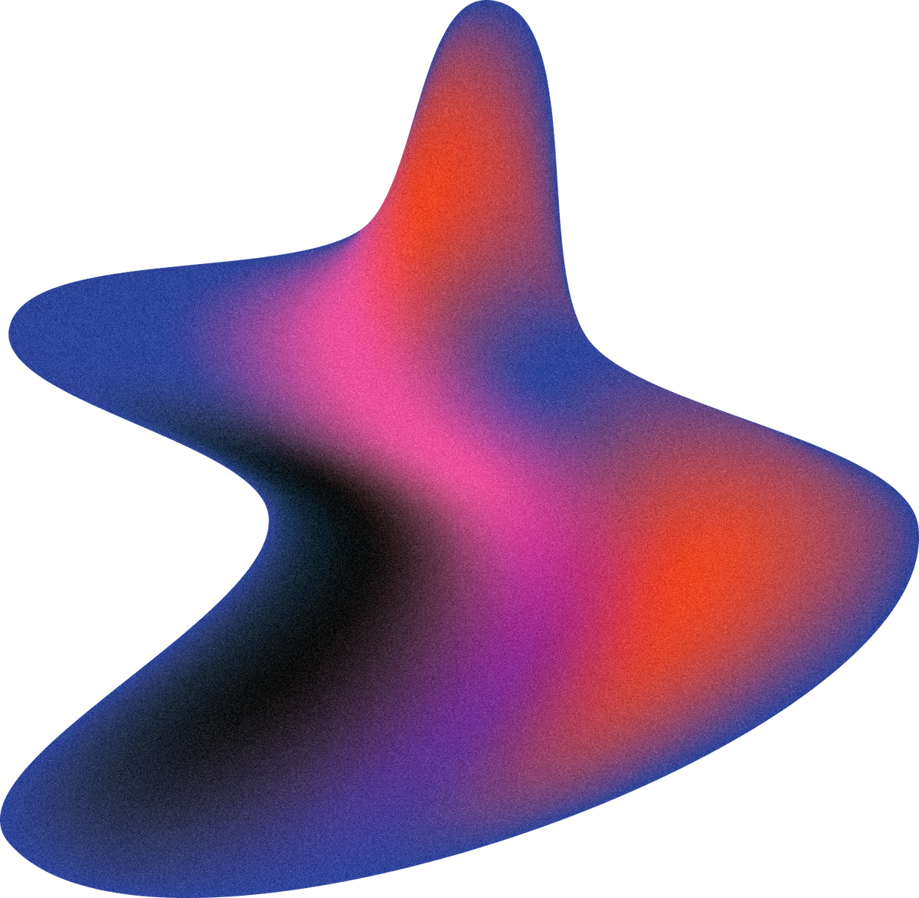
Research
Questions
What substantially different characteristics exist between phishing and legitimate sites?
How accurately can our model differentiate phishing from legitimate websites using 46 features?
What are the differences in behavioral patterns (e.g., form submissions, redirects) between phishing and legitimate websites, and how can these patterns improve phishing detection?
How do various classification models (e.g., logistic regression, decision trees, neural networks) compare in performance metrics?

Slide 4
Project Goal
To develop a machine learning model that can:
Accurately detect phishing websites based on behavioral and structural features.

Slide 5
Data Overview
Data Overview
Binary classification task: Phishing (1) vs. Legitimate (0)
Total features: 46
Sample size: [10,000 websites]
50/50 of legitimate and phishing
Label source: Expert-labeled phishing/legit sites
Train-test split:
70% train
30% test
Example features:
https_in_hostname
fake_status_bar_link
domain_in_subdomains
hostname_length
url_dot_count
rt_abnormal_form_action
url_underscore_count
pct_null_self_redirect_links
has_relative_form_action
pct_external_resources
Dataset: 10,000 webpages
50% are ph
Features: 46 features extracted from webpages and urls
Timeframe: Data from January-May 2015 and May-June 2017

Slide 6
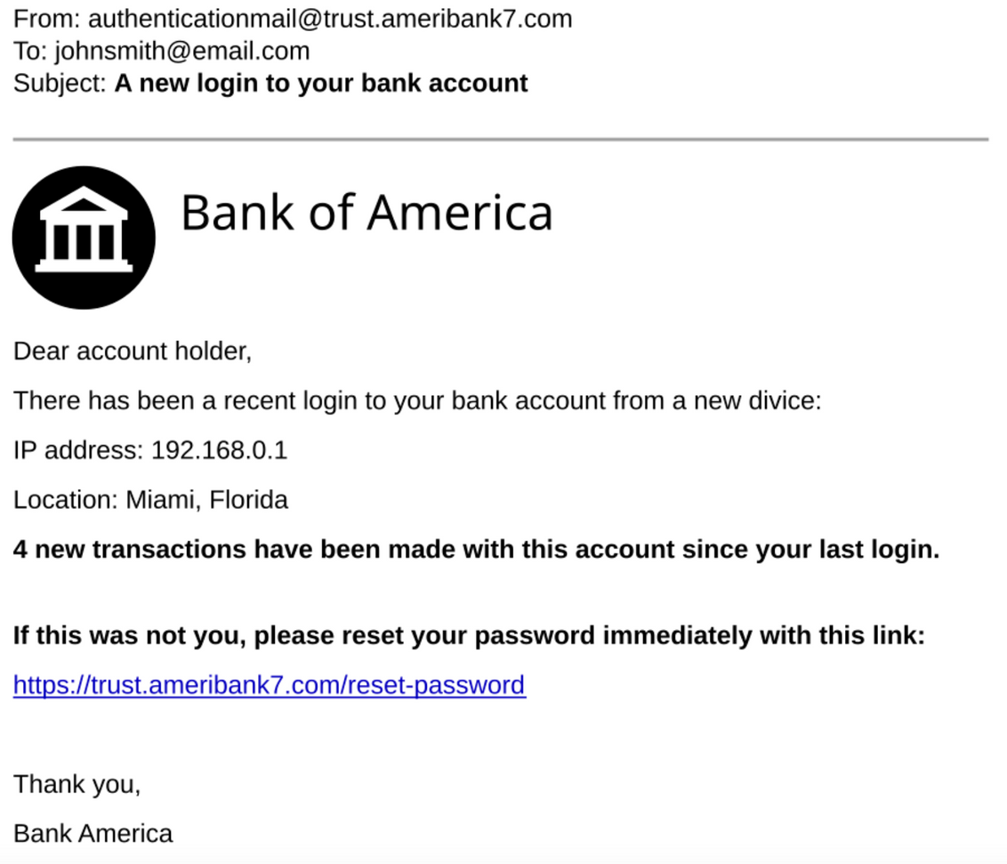

Phishing Example
Data Overview
Dataset: 10,000 webpages
50% are ph
Features: 46 features extracted from webpages and urls
Timeframe: Data from January-May 2015 and May-June 2017
Misleading subdomain, unusual numbers in the domain, and a mismatched banking name.

Slide 7
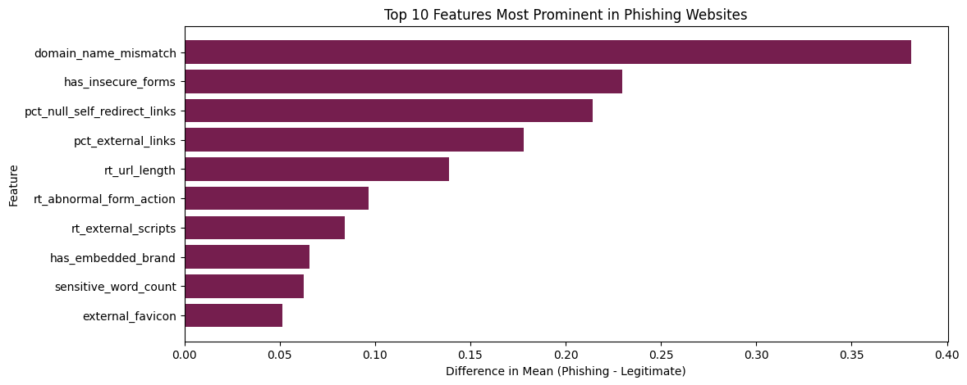
Phishing websites tend to feature characteristics like domain name mismatches, insecure forms, suspicious redirection links, external links, and misleading branding or sensitive words. These features are designed to deceive users into trusting the website.

Slide 8
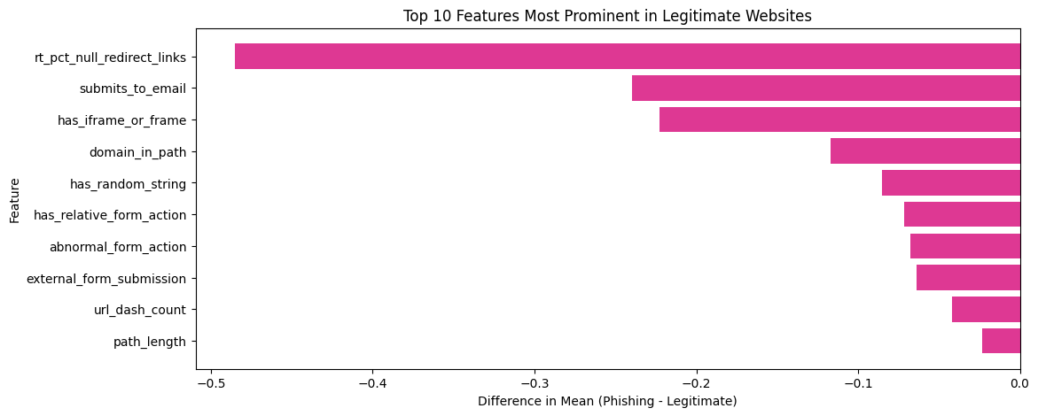
Legitimate websites, on the other hand, exhibit traits like fewer redirects, more secure form submission processes, and generally simpler, more structured URLs with fewer suspicious components (e.g., random strings, dashes, or insecure actions).

Slide 9
Models Used
Logistic Regression | A point system that weighs different features to make a yes/no decision.
Decision Tree | A flowchart of yes/no questions leading to a prediction.
Random Forest | Many decision trees voting together for better accuracy.
KNearestNeighbors | Judges a URL by the company it keeps.
Neural Network | Multiple layers of artificial neurons learning patterns like a simplified brain.
Gradient Boosting | A team of models where each new member fixes previous mistakes.
XGBoost | A supercharged version of gradient boosting for faster, more accurate predictions.

Slide 10
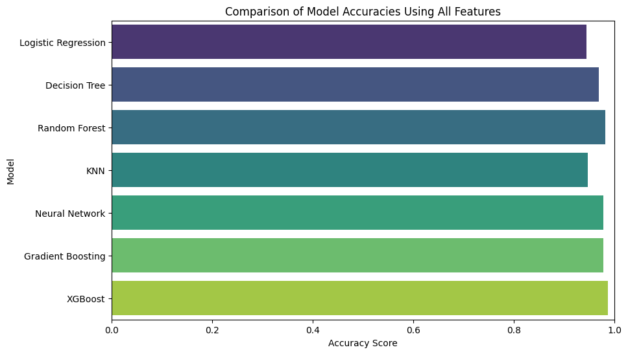
94%
97%
98%
95%
98%
98%
99%

Slide 11
XGBoost Model Results
Accuracy: 98.7%
Precision: 98.6%
Recall: 98.9%
F1 Score: 98.7%
Confusion Matrix
1441 | 22
17 | 1520
+
Why is the Accuracy so High?
Actual
Strong Feature Set: We have access to a lot of features, enough to provide accurate classification.
Balanced Precision & Recall: Suggests the model is not just good at detecting phishing sites but also at minimizing incorrect classifications.
-
-
+
Predicted
Notes:
Accuracy
How often the model is right overall.
Example: If it checks 100 websites and gets 98 correct, that’s 98% accuracy.
🎯 Precision
When the model says “phishing,” how often is it actually phishing?
High precision = few false alarms (legit sites wrongly flagged).
🔍 Recall
Out of all actual phishing sites, how many did the model catch?
High recall = few phishing sites are missed.
⚖️ F1 Score
A balance between precision and recall.
Useful when you want both: catch phishing sites and avoid false alarms.

Slide 12
XGBoost Model Results
Accuracy: 98.7%
Precision: 98.6%
Recall: 98.9%
F1 Score: 98.7%
Confusion Matrix
98.5% | 1.5%
1.1% | 98.9%
+
Why is the Accuracy so High?
Actual
Strong Feature Set: We have access to a lot of features, enough to provide accurate classification.
Balanced Precision & Recall: Suggests the model is not just good at detecting phishing sites but also at minimizing incorrect classifications.
-
-
+
Predicted

Slide 13
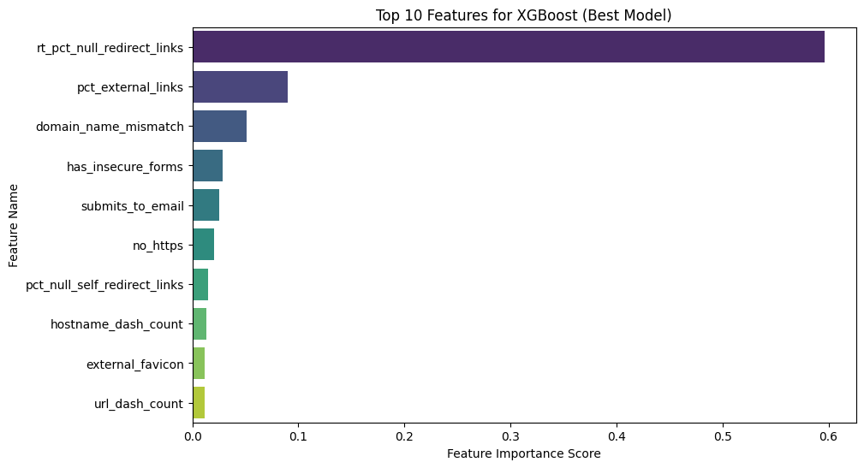
rt_pct_null_redirect_links had the highest importance score (~0.6), meaning phishing websites often use null redirect links (broken or missing redirects).
Phishing sites often use misleading links, insecure forms, and external elements to trick users.

Slide 14
Grouping Features
Shows patterns clearly: Helps reveal what categories have the most impact on the predictions.
Reduces noise: Small, random differences in the data matter less when features are grouped.

Slide 15
Groupings
🔗 URL Structure Features | url_dot_count, subdomain_depths
🔐 Security Indicators | no_https, uses_ip_address
🌐 Website Content Features | domain_in_subdomains(if main domain appears in subdomains), domain_in_path(whether the domain appears in the path)
🧠 Behavioral Features | right_click_disabled, has_popup_windows, missing_title
⚙️ Real-Time Execution | rt_subdomain_depth, rl_url_length, rt_external_scripts

Slide 16
Groupings
🔗 URL Structure Features | Characteristics of the URLS itself. Checks URL length, depth, and special characters.
🔐 Security Indicators | Indicators related to security mechanisms.
🌐 Website Content Features | Elements present in the webpages, such as words, branding, links, and form security.
🧠 Behavioral Features | Detects pop-ups, blocked clicks, and fake elements.
⚙️ Real-Time Execution | Runtime analysis when loading the webpage. Monitors live changes, redirects, and external resources.

Slide 18

How many times each feature (top 10) appears in grouping
Website Content Features
4
Phishing detection relies heavily on analyzing on-page elements
URL Structure Features
2
Often use hyphens or misleading domain names to appear similar to legitimate ones. Focuses on patterns.
Behavioral features
2
Harder to detect
Security indicators
1
no_https, most modern phishing sites use HTTPS, making this less predictive
Real-time Features
1
Rely on live monitoring, which can be challenging

Slide 19
Best Models for Each Grouping
🔗 URL Structure Features | Best model: XGBoost Best Feature: url_dash_count | F1 Score: 90.1%
🔐 Security Indicators | Best model: Gradient Boosting Best Feature: path_length | F1 Score: 74.8%
🌐 Website Content Features | Best model: XGBoost Best Feature: pct_external_links | F1 Score: 97.1%
🧠 Behavioral Features | Best model: Logistic Regression Best Feature: domain_name_mismatch | F1 Score: 79.2%
⚙️ Real-Time Execution | Best model: XGBoost Best Feature: rt_pct_null_redirect_links | F1 Score: 85.0%

Slide 20
Confusion Matrix
1409 | 54
51 | 1486
+
Actual
-
Important Features XGBoost Results (Best model overall)
-
+
Predicted
Accuracy: 96.5%
Precision: 96.5%
Recall: 96.7%
F1 Score: 96.6%

Slide 21
Confusion Matrix
1411 | 52
50 | 1487
+
Actual
-
Hyperparameter Tuning Process with XGBoost
-
+
Predicted
n_estimators: [50, 100, 200]
max_depth: [3, 6, 10]
learning_rate: [3, 6, 10]
subsample: [0.6, 0.8, 1.0]
colsample_bytree: [0.6, 0.8, 1.0]
Accuracy: 96.6%
Precision: 96.6%
Recall: 96.7%
F1 Score: 96.7%
Best Hyperparameters: {'colsample_bytree': 0.6, 'learning_rate': 0.1, 'max_depth': 10, 'n_estimators': 200, 'subsample': 0.8}
Notes:
XGBoost (Extreme Gradient Boosting) is an implementation of gradient boosting, which is a type of machine learning algorithm that builds a model by combining multiple decision trees in a sequential manner.
✅ colsample_bytree = 0.6 → Uses 60% of features per tree for better generalization.
✅ learning_rate = 0.1 → A moderate pace for stable learning.
✅ max_depth = 10 → Captures complex patterns without excessive overfitting.
✅ n_estimators = 200 → More boosting rounds improved accuracy.
✅ subsample = 0.8 → Uses 80% of data per tree for a balanced approach.

Slide 22
Why we chose this model with lower performance metrics:
The drop in accuracy (from 98.7% to 96.6%) is a reasonable trade-off for improved real-world usability, efficiency, and adaptability. If the goal is to detect phishing across a variety of websites where some features may be missing, this model is likely more practical and reliable in usage.
XGBoost Results (Best model overall)
Notes:
The slight drop in accuracy (from 98.7% to 96.6%) is a reasonable trade-off for improved real-world usability, efficiency, and adaptability. If the goal is to detect phishing across a variety of websites where some features may be missing, the second model is likely more practical and reliable in usage.

Slide 23
Conclusion

Slide 24
Research
Questions
What substantially different features exist between phishing and legitamate sites?
pct_external_links: High percentages of links pointing to external domains are common in phishing sites.
domain_name_mismatch: Phishing sites often display a domain name that doesn’t match the actual destination.
rt_pct_null_redirect_links: Indicates the use of broken or deceptive redirects.
These features influence model predictions by capturing the structural and behavioral red flags that are typical of phishing websites.
How accurately can our model differentiate phishing from legitimate websites using 46 features?
What are the differences in behavioral patterns (e.g., form submissions, redirects) between phishing and legitimate websites, and how can these patterns improve phishing detection?
How do various classification models (e.g., logistic regression, decision trees, neural networks) compare in performance metrics?

Slide 25
Research
Questions
What substantially different characteristics exist between phishing and legitamate sites?
How accurately can our model differentiate phishing from legitimate websites using 46 features?
Our best performing model, XGBoost, achieved:
Accuracy: 98.70%
Precision: 98.57%
Recall: 98.89%
F1 Score: 98.73%
Our model not only catches nearly all phishing site (high recall), but also avoids misclassifying legitimate ones (high precision).
What are the differences in behavioral patterns (e.g., form submissions, redirects) between phishing and legitimate websites, and how can these patterns improve phishing detection?
How do various classification models (e.g., logistic regression, decision trees, neural networks) compare in performance metrics?

Slide 26
Research
Questions
What substantially different characteristics exist between phishing and legitamate sites?
Behavior Type | Phishing Sites (1) | Legitimate Sites (0) | Insight
domain_name_mismatch | 0.4060 | 0.0246 | Huge difference – phishing sites frequently spoof domains
missing_title | 0.0528 | 0.0116 | Phishing pages often lack proper page titles
right_click_disabled | 0.0228 | 0.0052 | Phishing sites try to block inspection or copying
has_iframe_or_frame | 0.2282 | 0.4510 | Surprisingly less frequent in phishing – legit sites use iframes more often
How accurately can our model differentiate phishing from legitimate websites using 46 features?
What are the differences in behavioral patterns (e.g., form submissions, redirects) between phishing and legitimate websites, and how can these patterns improve phishing detection?
How do various classification models (e.g., logistic regression, decision trees, neural networks) compare in performance metrics?

Slide 27
Research
Questions
What substantially different characteristics exist between phishing and legitamate sites?
What This Tells Us
Phishing websites are highly likely to mismatch domain names and lack proper metadata like titles.
They more often disable right-click as an evasion technique.
How This Improves Detection
Models can learn from these behavioral traits, rather than relying on visual features.
These patterns are harder for attackers to fake, making detection more resilient to simple spoofing techniques.
Including behavioral features leads to better recall and precision.
How accurately can our model differentiate phishing from legitimate websites using 46 features?
What are the differences in behavioral patterns (e.g., form submissions, redirects) between phishing and legitimate websites, and how can these patterns improve phishing detection?
How do various classification models (e.g., logistic regression, decision trees, neural networks) compare in performance metrics?

Slide 28
Research
Questions
What substantially different characteristics exist between phishing and legitamate sites?
How accurately can our model differentiate phishing from legitimate websites using 46 features?
XGBoost is the top performer, followed closely by Random Forest and Gradient Boosting.
This proves that tree-based ensemble models are particularly effective for phishing detection on this dataset.
This is because tree-based models find patterns when features interact – like when a site has a fake domain and an insecure form. They don’t need data to be scaled or cleaned up.
What are the differences in behavioral patterns (e.g., form submissions, redirects) between phishing and legitimate websites, and how can these patterns improve phishing detection?
How do various classification models (e.g., logistic regression, decision trees, neural networks) compare in performance metrics?

Slide 29
How do various classification models (e.g., logistic regression, decision trees, neural networks) compare in performance metrics?
Model | Accuracy | Precision | Recall | F1 Score
XGBoost | 98.70% | 98.57% | 98.89% | 98.73%
Random Forest | 98.17% | 98.24% | 98.18% | 98.21%
Gradient Boosting | 97.77% | 97.85% | 97.79% | 97.82%
Neural Network | 96.90% | 96.88% | 97.07% | 96.98%
Decision Tree | 96.70% | 96.57% | 97.01% | 96.79%
Logistic Regression | 94.13% | 93.87% | 94.73% | 94.30%
K-Nearest Neighbors | 86.70% | 85.30% | 89.46% | 87.33%

Slide 30
THANK YOU
ANY QUESTIONS?

